Slide 1
CMPE493: Introduction to IR Term Project: Named Entity Normalization for the Bacteria Biotopes Domain
Mansur YeşİLBursa
Abdullah Yıldız
Can Devecİ

Slide 2
Overview
Part 1: Mansur_part_name, Mansur Yeşilbursa
Part 2: Abdullah_part_name, Abdullah Yıldız
Part 3: Future Work, Can Deveci

Slide 3
Mansur_part_name

Slide 4
Mansur_part_name

Slide 5
Performance Problems
Input Term | Normalized Term | True Normalized Term
CD20-positive cells | phagocyte | lymphocyte
lymphocytic | nutrient broth | lymphocyte
B cells | phagocyte | lymphocyte
T cells | phagocyte | lymphocyte
lymphocytic | nutrient broth | lymphocyte
Predicts phagocyte instead of lymphocyte although input containts lymphocytic.
nltk.wordnet.WordNetLemmatizer()
e.g. lymphocytic -> lymphocytic
Lemmatization could not lemmatize scientific terms.
Cells -> phagocyte
..cytic -> nutrient broth

Slide 6
Performance Problems
Input Term | Normalized Term | True Normalized Term
patients with atypical lymphoid infiltrates | elderly person | patient
patients with low-grade MALT lymphoma | elderly person | patient
patients with Helicobacter pylori-chronic active gastritis | elderly person | patient with infectious disease
patients with high-grade primary gastric lymphoma | elderly person | patient
patients with chronic active gastritis | elderly person | patient
Predicts elderly person instead of patient
Associates certain words to certain entities.

Slide 7
Performance Problems
Input Term | Normalized Term | True Normalized Term
placenta of a 38-year-old secondary recurrent aborter | experimental medium | placenta
38-year-old secondary recurrent aborter | experimental medium | pregnant woman
Part of speech tagging can be applied to first sentence for morphological analysis.
Sentence is split into phrases.

Slide 8
Performance Problems
Input Term | Normalized Term | True Normalized Term
placenta of a 38-year-old secondary recurrent aborter | experimental medium | placenta
38-year-old secondary recurrent aborter | experimental medium | pregnant woman
Part of speech tagging can be applied to first sentence for morphological analysis.
Sentence is split into phrases.

Slide 9
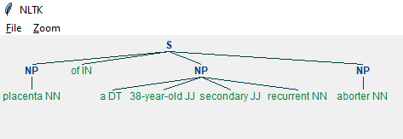
Performance Problems
Part of speech tagging can be applied to first sentence
Test = ‘placenta of a 38-year-old secondary recurrent aborter ‘
(S (NP placenta/NN) of/IN (NP a/DT 38-year-old/JJ secondary/JJ recurrent/NN) (NP aborter/NN))
JJ : adjective
NP: noun phrase
S: sentence
DT: determiner

Slide 10
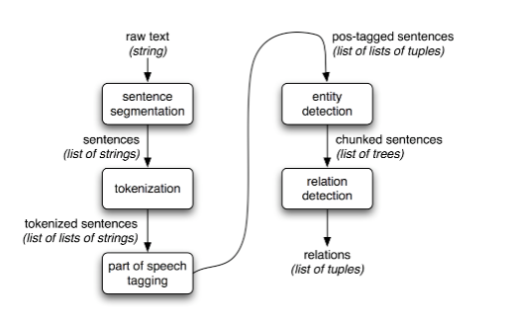
Performance Problems
Architecture for a simple information extraction system
Ref : https://www.nltk.org/book/ch07.html

Slide 11
Ontology
There is an Ontology implementation in Python written by Martin Larralde.
Reference : github.com/althonos
Given an .obo document.
Creates the graph representation of Ontology Terms by implementing the specifications of the Open Biomedical Ontologies 1.4

Slide 12
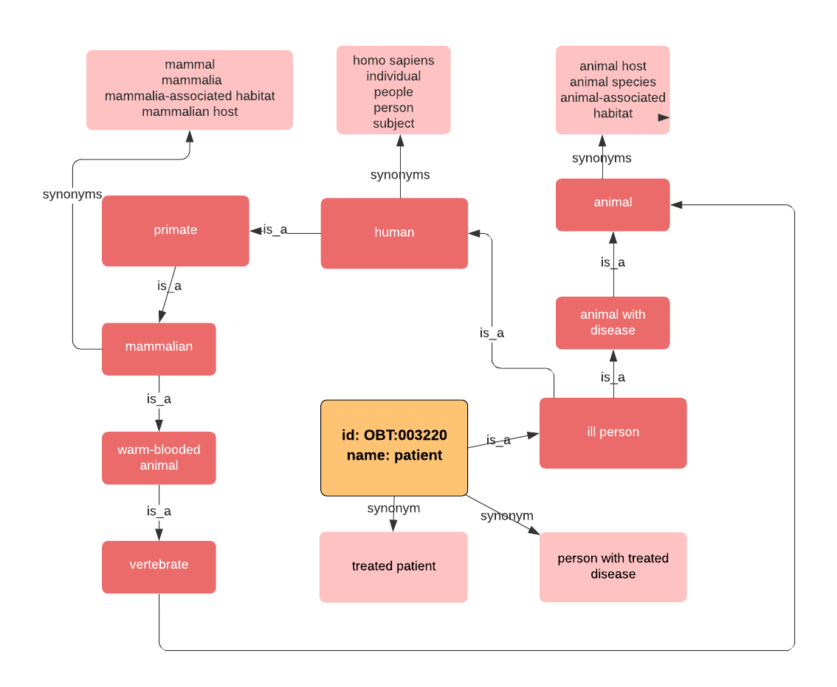
Ontology Library - Pronto
Starts from the Patient (OBT:003220 ) term.
Whole graph can be induced by following is_a and synonym relationships.
Pronto library has superclasses and subclasses functions to return relevant Ontology terms.

Slide 13
Ontology Library - Pronto
Superclasses of ‘Patient’
'root for extraction’
'microbial habitat’
'living organism’
'eukaryote host’
'animal’
'animal with disease’
'vertebrate’
'warm-blooded animal’
'mammalian’
'primate’
'human’
'ill person'

Slide 14
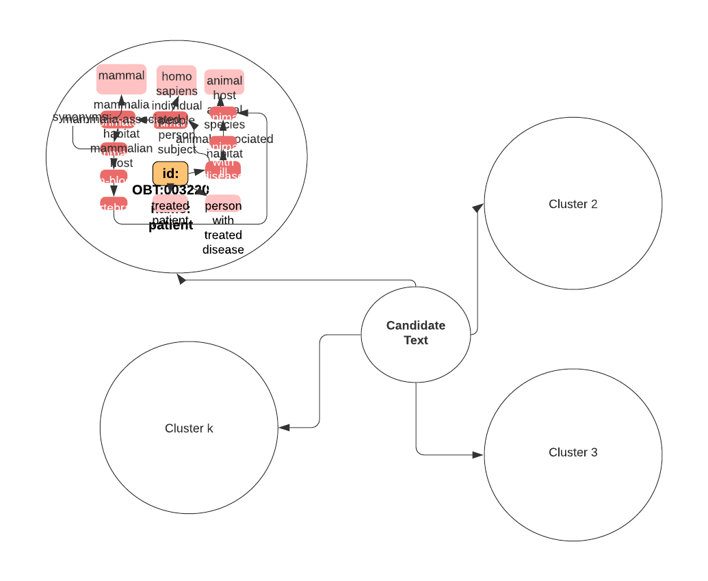
Ontology Library - Pronto
K-Means Clustering
Nearest cluster can be selected for candidate text.

Slide 15
Future Work
Paper 1
Paper 2
Paper 3

Slide 16
Paper 1

Slide 17
Paper 2

Slide 18
Paper 3

